Slide 1



kuberneteS
Nitin Kumar Gaur
Batch : 89
EMP ID: 6168

Slide 2
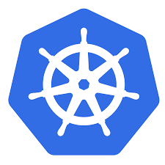
Why kuberneteS
With modern web services, users expect applications to be available 24/7, and developers expect to deploy new versions of those applications several times a day. Containerization helps package software to serve these goals, enabling applications to be released and updated without downtime.

Slide 3
KUBERNETES
Kubernetes is an open-source container-orchestration system for automating computer application deployment, scaling, and management. It was originally designed by Google and is now maintained by the Cloud Native Computing Foundation.
Kubernetes is an open source software tool for managing containerised workloads. It enables development teams to automate the deployment, scaling and management of applications.
Its also know as K8S.
Language used : GO.
Original author : Google.
Initial release: 7 June 2014; 7 years ago

Slide 4
K8S provides several key features that allow us to run immutable infrastructure. Containers can be killed, replaced, and self-heal automatically, and the new container gets access to those support volumes, secrets, configurations
Kubernetes extends how we scale containerized applications so that we can enjoy all the benefits of a truly immutable infrastructure. The general rule of thumb for K8S: if your app fits in a container, Kubernetes will deploy it.
Benefits of Kubernetes
Self-healing (Kubernetes can auto-restore from errors by rolling back to the last working version of the software)
High Availability
(If there is a server failure, containers can be recreated on a working node to avoid downtime.)
Simplifies Maintenance (This means services don’t have to go offline to be maintained.)

Slide 5
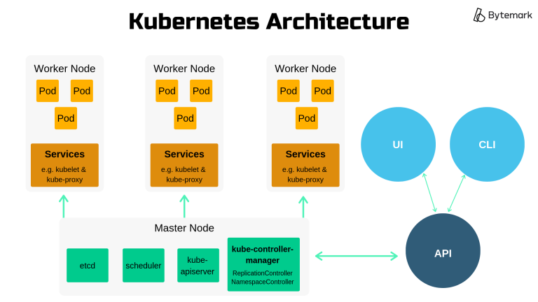

Slide 6
THANK YOU

